Slide 1
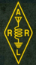
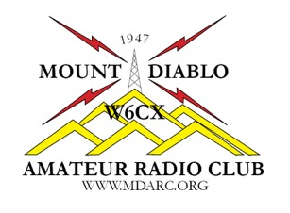
Chapter 4
Propagation, Antennas and Feed Lines
Name, Callsign
Discussion Leader
American Radio Relay League

Slide 2
Brief Review of Chapter 2 Exam Questions
How does the wavelength of a radio wave relate to its frequency?
The wavelength gets longer as the frequency increases
The wavelength gets shorter as the frequency increases
There is no relationship between wavelength and frequency
The wavelength depends on the bandwidth of the signal
2019 MDARC Technician License Course

Slide 3
Brief Review of Chapter 2 Exam Questions
How does the wavelength of a radio wave relate to its frequency?
The wavelength gets shorter as the frequency increases
T3B05 Page 2-5
2019 MDARC Technician License Course

Slide 4
Brief Review of Chapter 2 Exam Questions
What describes the number of times per second that an alternating current makes a complete cycle?
Pulse rate
Speed
Wavelength
Frequency
2019 MDARC Technician License Course

Slide 5
Brief Review of Chapter 2 Exam Questions
What describes the number of times per second that an alternating current makes a complete cycle?
Frequency
T5A12 Page 2-3
2019 MDARC Technician License Course

Slide 6
Brief Review of Chapter 2 Exam Questions
What is a transceiver?
A type of antenna switch
A unit combining the functions of a transmitter and a receiver
A component in a repeater which filters out unwanted interference
A type of antenna matching network
2019 MDARC Technician License Course

Slide 7
Brief Review of Chapter 2 Exam Questions
What is a transceiver?
A unit combining the functions of a transmitter and a receiver
T7A02 Page 2-7
2019 MDARC Technician License Course

Slide 8


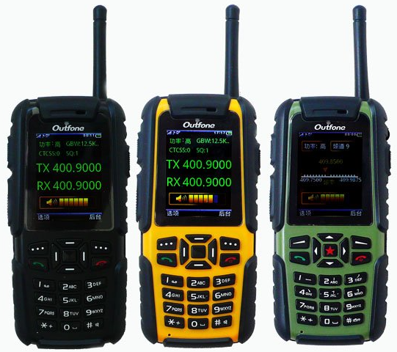
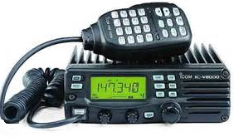
Chapter 4 Propagation, Antennas and Feed Lines
Last session we learned about radio and signal fundamentals.
In tonight’s session we look at how we get those radio signals from one point to other points.
2019 MDARC Technician License Course
8

Slide 9
Chapter 4 4.1 Propagation
Definition: The method by which radio waves travel.
Just like light, radio waves spread out from an antenna in straight lines unless refracted or diffracted along the way.
Propagation at and above VHF frequencies assisted by atmospheric phenomena such as weather fronts or temperature inversion is called tropospheric propagation.
2019 MDARC Technician License Course
9

Slide 10
Chapter 4 4.1 Propagation
The ionosphere
Above the lower atmosphere where the air is relatively dense and below outer space where there isn't any at all lies the ionosphere. This region is from 30 to 260 miles above the earth.
The ionosphere forms in layers with the D layer being the lowest.
Radio waves at HF (and sometimes VHF) can be completely bent back toward the earth by refraction in the ionosphere's E and F layers.
10

Slide 11
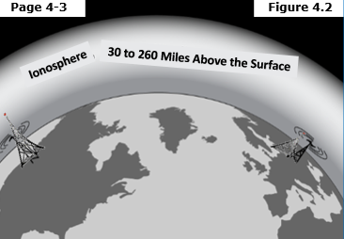
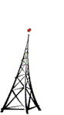
Chapter 4 4.1 Propagation
The ionosphere
The ionosphere is bombarded by ultraviolent light from the sun that knocks off electrons from the oxygen and nitrogen atoms resulting in positively charged ions.
Figure 4.3
2019 MDARC Technician License Course
11

Slide 12
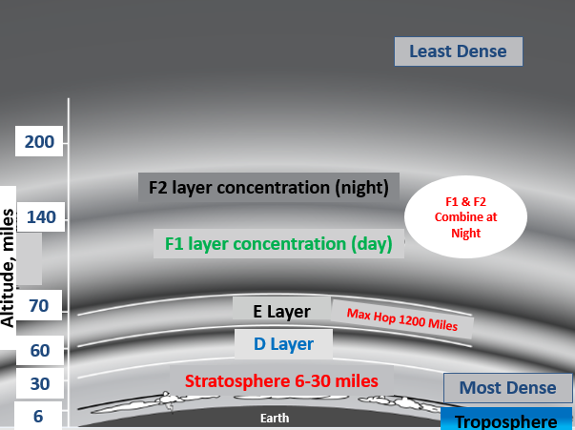
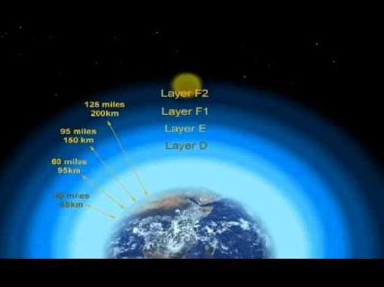
Chapter 4 4.1 Propagation
The ionosphere
The ionosphere forms layers that are labeled as D, E, F1 and F2 layers. The D layer is the lowest layer.
Adapted from Figure 4.2
2019 MDARC Technician License Course
12

Slide 13
Chapter 4 4.1 Propagation
Higher Frequency waves are bent less than those of lower frequencies.
The Highest Frequency Signal that can be reflected back to a point on the earth is the maximum usable frequency (MUF) between the transmitter and receiver.
When sky-wave propagation on an amateur band is possible between two points, the band is said to be open.
The lowest frequency that can travel between two points without being absorbed is the lowest usable frequency (LUF).
2019 MDARC Technician License Course
13

Slide 14
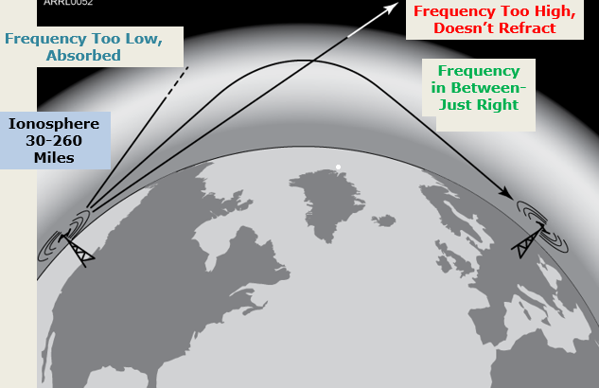
Chapter 4 4.1 Propagation
Illustration for MUF and LUF
Signals too low in frequency are absorbed by the ionosphere; those that are too high pass through and are lost.
Signals in the right range of frequencies are refracted back towards the earth.
2019 MDARC Technician License Course
14

Slide 15
Chapter 4 4.2 Antenna and Radio Wave Basics
A Feed Line delivers the radio signals to and/or from the antenna.
The Feed Point is the connection of the antenna and the feed line.
The ratio of radio frequency voltage to current at an antenna’s feed point is the antenna’s Feed Point Impedance.
An antenna is resonant when its feed point impedance is all resistance with no reactance.
2019 MDARC Technician License Course
15

Slide 16
Chapter 4 4.2 Antenna and Radio Wave Basics
A radio wave is a combination of an electrical and a magnetic field and is called and electromagnetic wave.
Polarization refers to the orientation of the radio’s electric field.
A horizontally polarized antenna radiates a radio wave whose electric field is oriented horizontally.
A vertically polarized antenna has an electric field perpendicular to the surface of the earth.
When the electric field of the radio wave and the element of the antenna have the same polarization, the maximum amount of signal is created in the antenna by the wave.
2019 MDARC Technician License Course
16

Slide 17
Chapter 4 4.2 Antenna and Radio Wave Basics
The concentration of radio signals in a specific direction is called gain.
Antenna gain increases signal strength in a specified direction when compared to a reference antenna.
Gain aids communication in the preferred direction by increasing transmitted and received signal strengths.
Gain only focuses power -- it does not create power.
An isotropic antenna has no gain because it radiates equally in every possible direction. An isotropic antenna does not exist in the real world but is used as an imaginary reference.
Antenna Gain
2019 MDARC Technician License Course
17

Slide 18
Chapter 4 4.2 Antenna and Radio Wave Basics
An omnidirectional antenna radiates a signal equally in every horizontal direction.
An antenna’s gain is specified in decibels (dB) with respect to some type of reference antenna which is most often the isotropic antenna which uses the abbreviation dBi.
The abbreviation dBd means gain with respect to a dipole antenna’s peak gain.
Antenna Gain
2019 MDARC Technician License Course
18

Slide 19
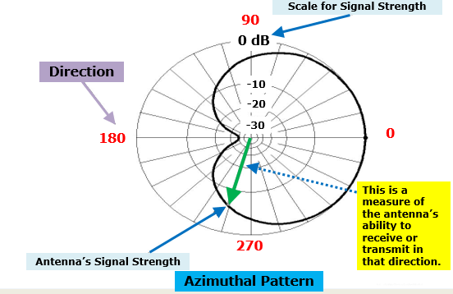
Chapter 4 4.2 Antenna and Radio Wave Basics
RF Radiation Patterns
This Azimuthal pattern shows the gain in a horizontal pattern around the antenna as an imaginary reference.
Adapted from Figure 4.5
As if looking down on the antenna
2019 MDARC Technician License Course
19

Slide 20
Chapter 4 4.2 Antenna and Radio Wave Basics
An elevation pattern shows the strength of the related energy in vertical directions.
An antenna’s radiation pattern may change with frequency changes.
The region of the radiation pattern in which the antenna’s gain is greatest is called the main lobe.
The ratio of gain in the preferred or forward direction to that in the opposite direction is called the front–to–back ratio.
RF Radiation Patterns
2019 MDARC Technician License Course
20

Slide 21
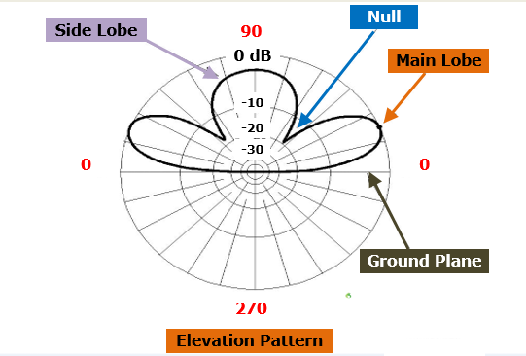
Chapter 4 4.2 Antenna and Radio Wave Basics
RF Radiation Patterns
This Elevation pattern looks at the antenna from the side to see how well it receives and transmits at different angles above a horizontal plane.
Adapted from Figure 4.6
As if looking from the side of the antenna
2019 MDARC Technician License Course
21

Slide 22
Chapter 4 4.3 Feed Lines and SWR
Coaxial Cable . . . The coaxial cable carries the radio signal between the center conductor and the inside surface of the shield.
Open-wire Feed Line . . . This type of feed line has less insulating material and greater spacing between its conductors, so it has less loss than coaxial cable.
Characteristic Impedance . . . Feed lines have a characteristic impedance which is denoted by Z₀, a measurement of how energy is carried by the feed line.
2019 MDARC Technician License Course
22

Slide 23
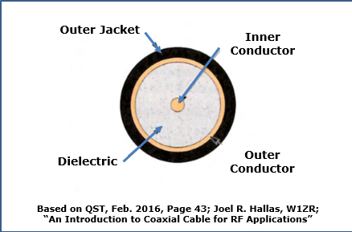
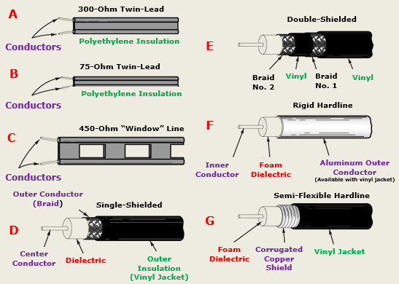
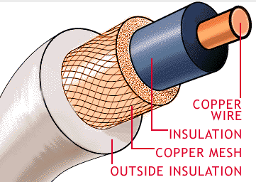
Chapter 4 4.3 Feed Lines and SWR
Examples of Coaxial Cables
2019 MDARC Technician License Course
23

Slide 24
Chapter 4 4.3 Feed Lines and SWR
.
Standing Wave Ratio (SWR)
Definition: Reflected and forward power traveling in opposite directions create a stationary wave-like interference pattern in the feed line called a standing wave.
The ratio of the maximum value to minimum value of the interference pattern is called the standing wave ratio or SWR.
When there is no reflected power there is no interference pattern and the SWR is 1:1. (a perfect match).
2019 MDARC Technician License Course
24

Slide 25
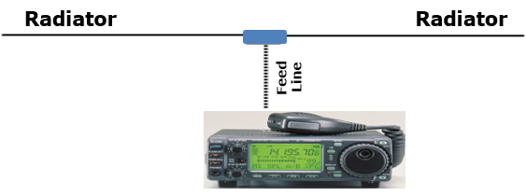
Chapter 4 4.4 Practical Antenna Systems
Dipoles and Ground-planes
The simplest type of antenna is a dipole, meaning essentially "two electrical parts.“
A dipole radiates strongest broadside to the axis of the dipole and weakest off of the ends.
2019 MDARC Technician License Course
25

Slide 26
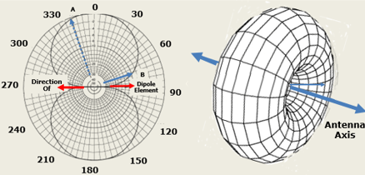
Chapter 4 4.4 Practical Antenna Systems
Radiation Pattern in the plane of a dipole located in space
Adapted from Figure 4.9
2019 MDARC Technician License Course
26

Slide 27
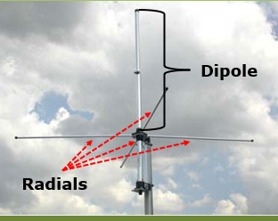
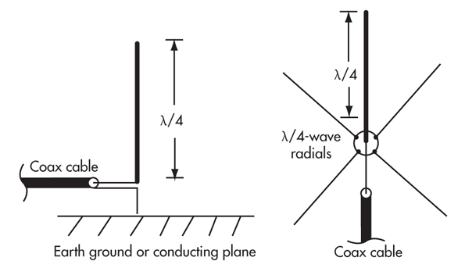
Chapter 4 4.4 Practical Antenna Systems
The common type of ground-plane antenna is one half of a dipole (¼ λ long) mounted vertically with the missing portion made up by an electrical “mirror” called the ground-plane which is made from sheet metal or a screen of wires called radials.
2019 MDARC Technician License Course
27

Slide 28
Chapter 4 4.4 Practical Antenna Systems
The length of a ground-plane antenna is half that of a dipole and is often estimated as: length (in feet) = 234/frequency (in MHz).
A good ground-plane should extend at least ¼ wave length from the base of the antenna in all directions . . . ground- plane antennas are often called verticals or monopoles.
Good examples of practical vertical antennas are the small whips placed on the roofs of trunks of cars.
2019 MDARC Technician License Course
28

Slide 29
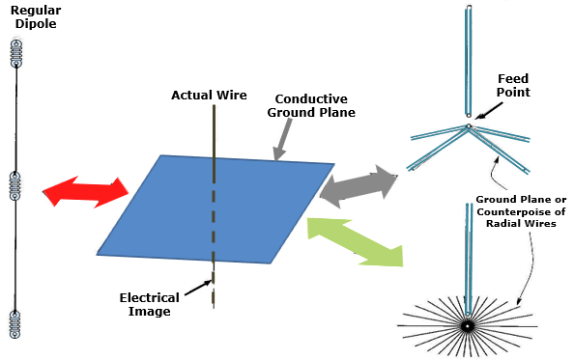
Chapter 4 4.4 Practical Antenna Systems
Ground-Plane Antennas
Making a 2-meter (146 MHz) Ground-Plane Antenna
Begin by using the formula 234/146 = 19.23 inches. Start with a length of 20 inches and use a SWR bridge or analyzer to trim the antenna to resonance at 146MHz.
Adapted from Figure 4.10
2019 MDARC Technician License Course
29

Slide 30
Chapter 4 4.4 Practical Antenna Systems
Directional Antennas
Directional antennas referred to as beams can be used to increase signal level at a distant station or to reject interference or noise.
Beams are created from arrays of multiple elements. (Dipoles and ground planes are single-element antennas.)
The two most widely used types of beam antennas are Yagi's and quads.
2019 MDARC Technician License Course
30

Slide 31
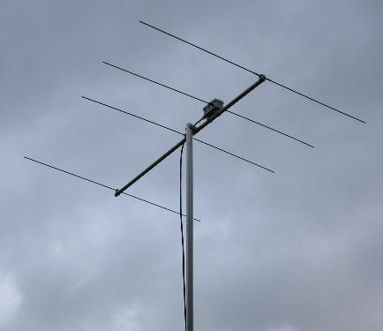
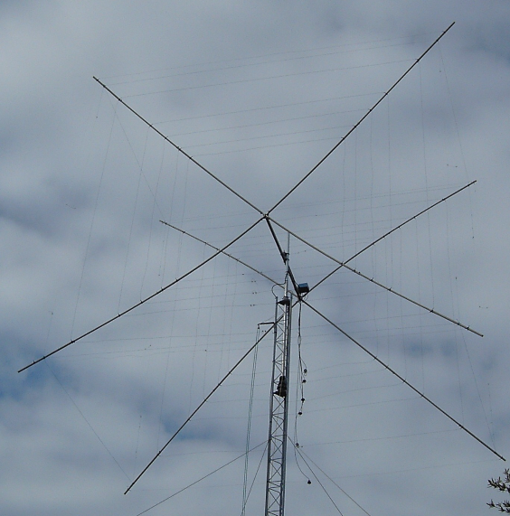
Chapter 4 4.4 Practical Antenna Systems
Beam Antennas
Yagi Antenna
Quad Antenna
Refer to Figure 4.12
2019 MDARC Technician License Course
31

Slide 32
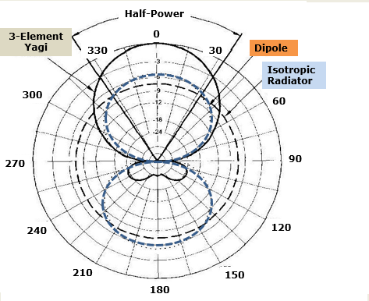
Chapter 4 4.4 Practical Antenna Systems
Yagi Antennas
The radiation pattern of a typical three element Yagi antenna with a driven element, reflector, and director that focus most of the antenna’s energy in one direction along the boom of the antenna.
Horizontally polarized Yagis and quads are usually used for long-distance communications, especially for weak signal SSB and CW contacts on the VHF and UHF bands.
Adapted from Figure 4.13
2019 MDARC Technician License Course
32

Slide 33
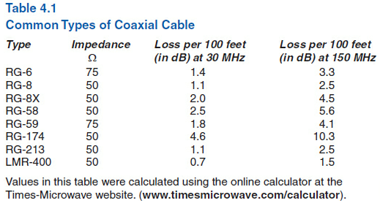
Chapter 4 4.4 Practical Antenna Systems
.
Feed Line Selection and Maintenance
Next to characteristic impedance, the most important characteristic of coax is feed line loss.
Loss is specified in dB per 100 feet of cable at a specific frequency.
2019 MDARC Technician License Course
33

Slide 34
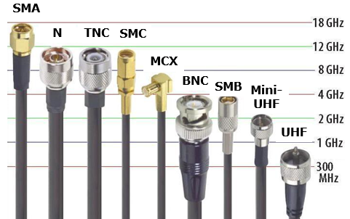
Chapter 4 4.4 Practical Antenna Systems
.
Feed Line Selection and Maintenance
There are several common types of coaxial connectors.
The UHF series of connectors, also called PL 259s, are the most widely used for HF equipment.
For frequencies above 400 MHz, the type N connectors are used.
Also refer to Figure 4.15
2019 MDARC Technician License Course
34

Slide 35
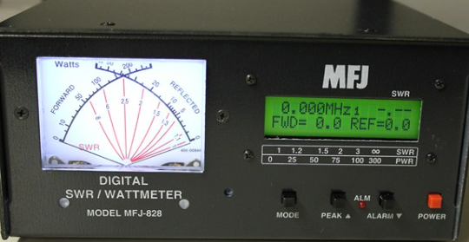
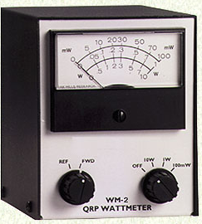
Chapter 4 4.4 Practical Antenna Systems
SWR Meters and Wattmeters
The SWR meter measures power flowing toward the antenna (forward) and toward the transmitter (reflected or reverse).
Wattmeters measure power in a feed line and can be placed in the line to read power flowing in either direction. The operator can then convert the forward and reflected power readings to SWR by using a table or formula.
2019 MDARC Technician License Course
35

Slide 36
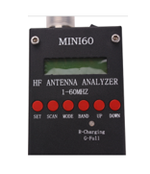
Chapter 4 4.4 Practical Antenna Systems
Antenna Tuners and Antenna Analyzers
Antenna Analyzers
An antenna analyzer is used to measure an antenna system without using a transmitter whose signal might cause interference. It can be connected to a feed line in place of an SWR meter or directly to an antenna.
An antenna analyzer can be used to determine the frequency at which an antenna is resonant.
2019 MDARC Technician License Course
36

Slide 37
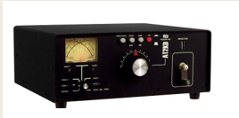
Chapter 4 4.4 Practical Antenna Systems
Antenna Tuners and Antenna Analyzers
Antenna Tuners
An antenna tuner does not really tune the antenna -- instead it's the impedance at the output of the feed line that is converted to some other value.
37

Slide 38

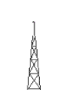


Class Session 7 Assignment
In preparation for the next class session, do the following…….
Chapter 5 “Amateur Radio Equipment”
Chapter 9: “Safety”
● Study the Question Pool questions found in the ”blue boxes” in these chapters.
2019 MDARC Technician License Course
38

Slide 39
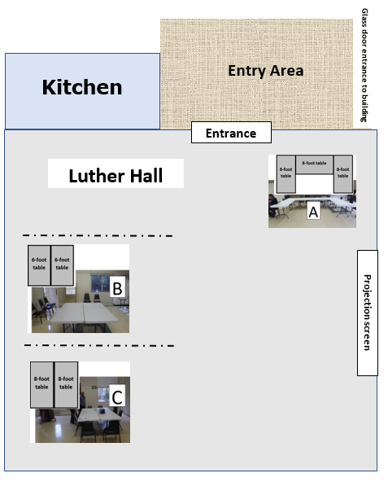
Please follow the Elmers’ directions

